Slide 1

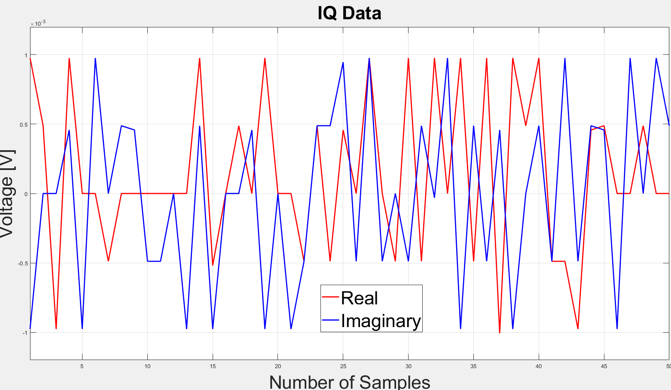
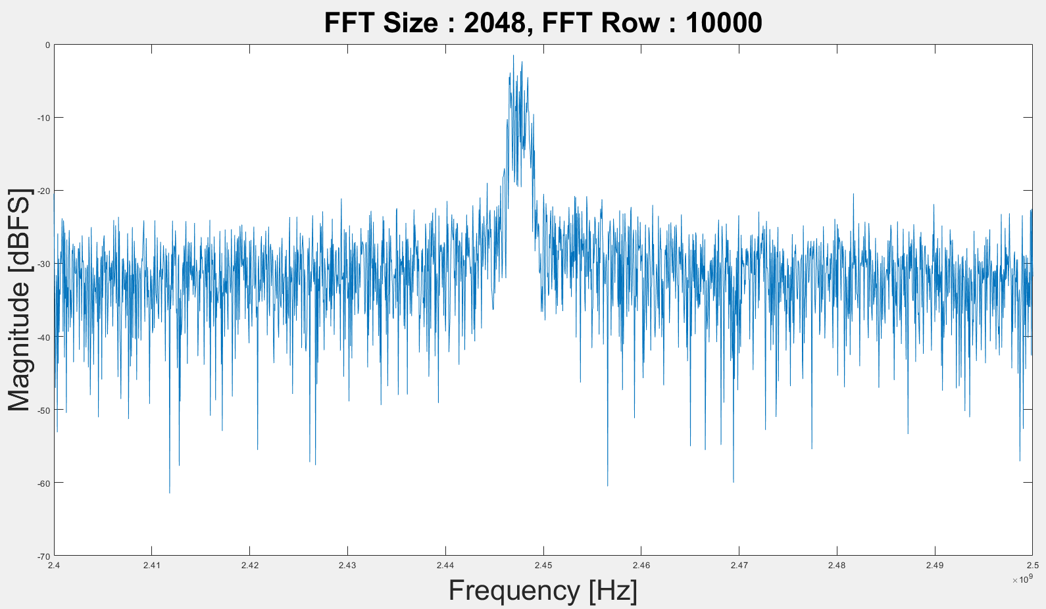
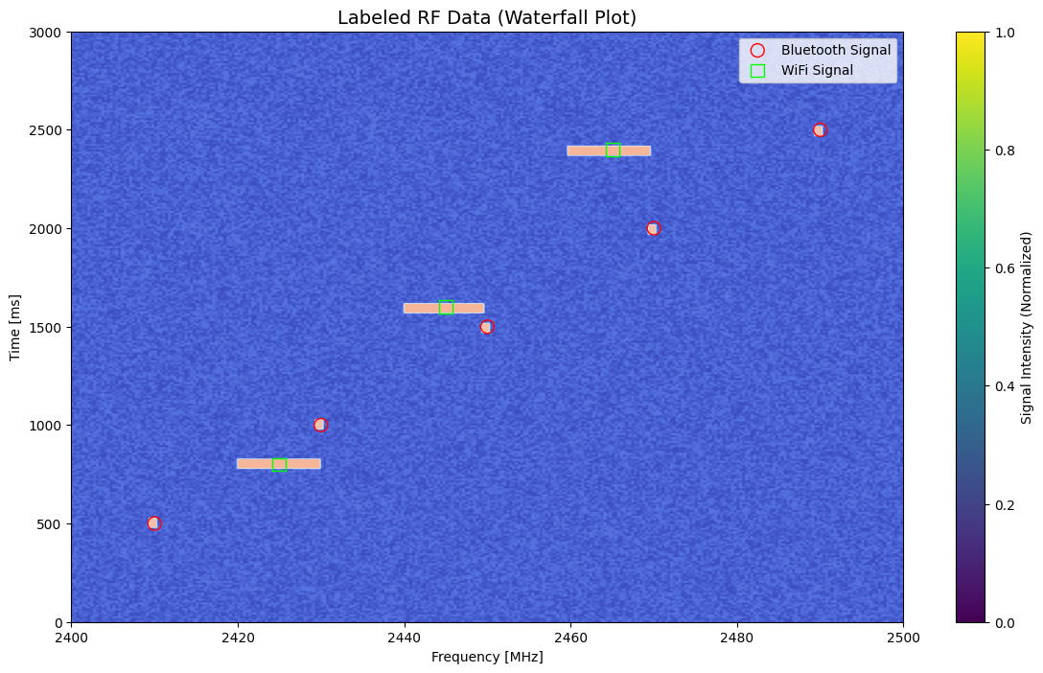
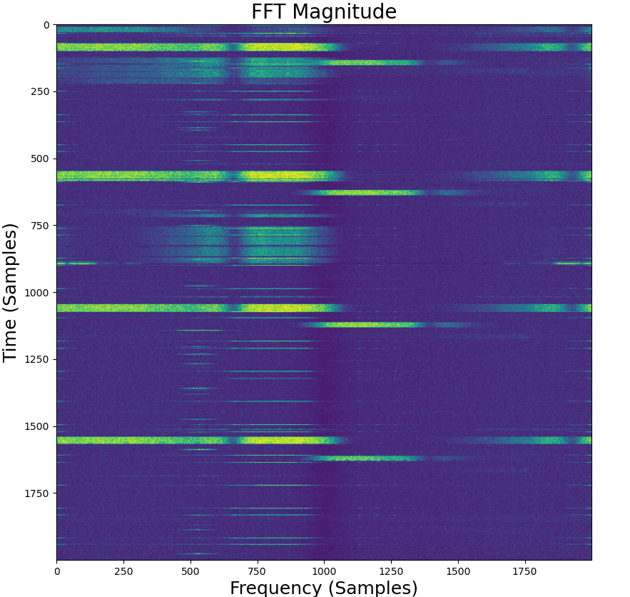
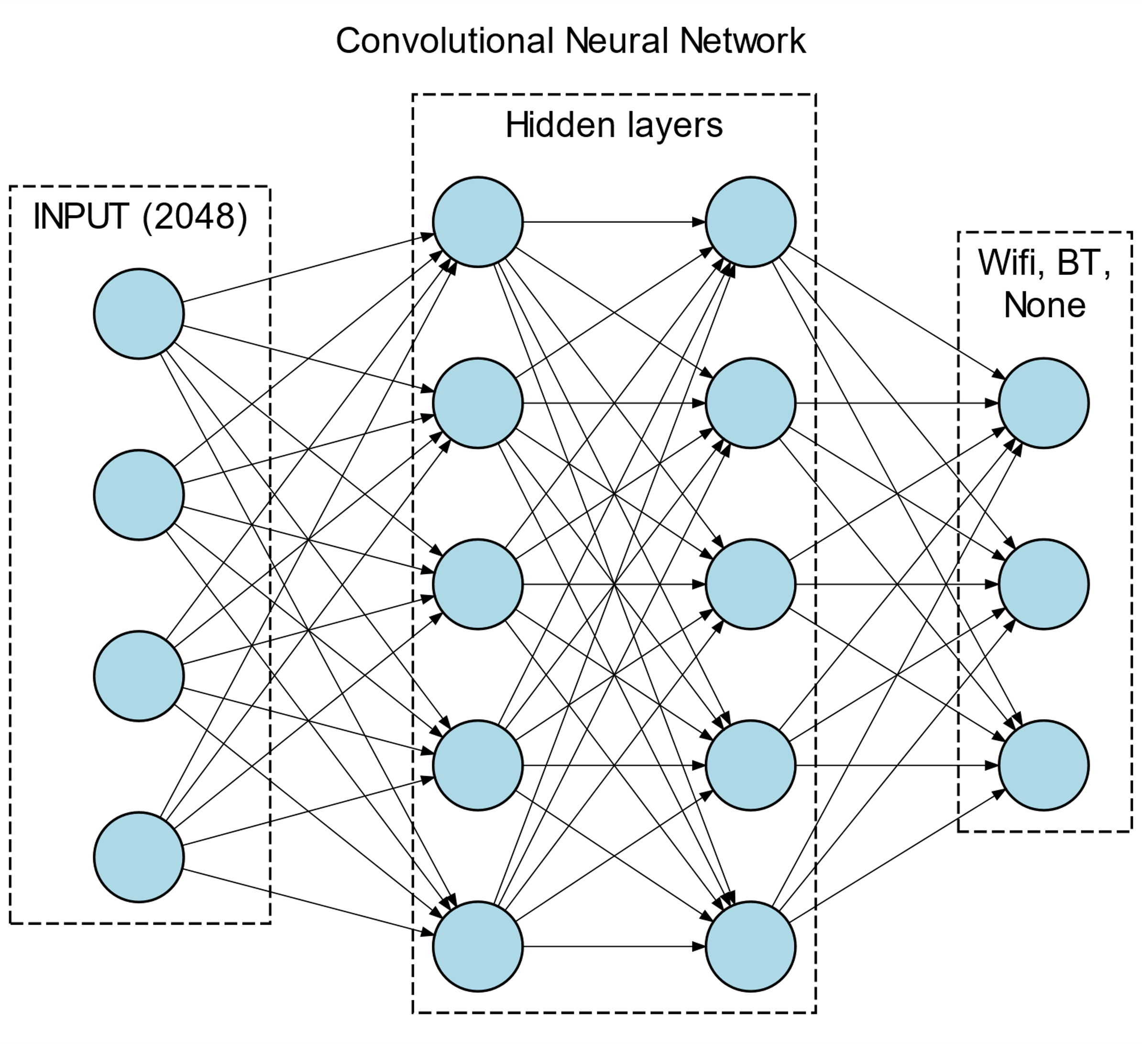
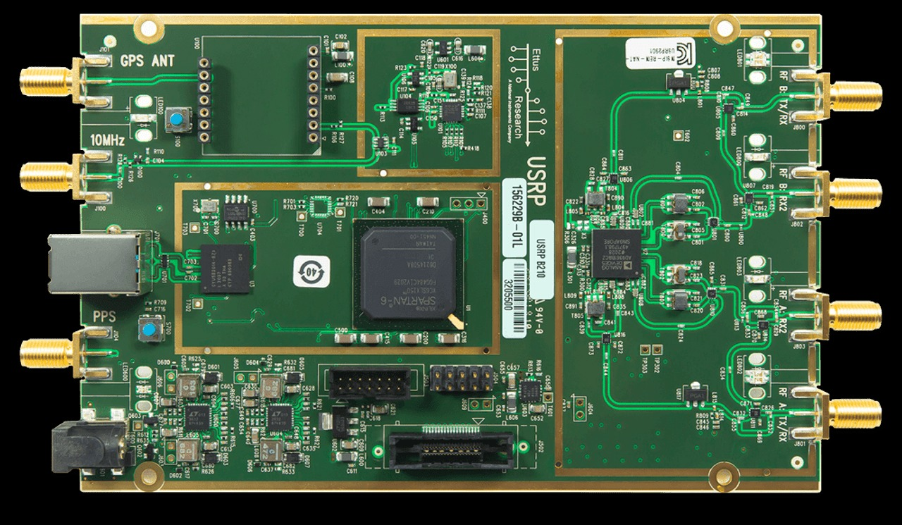
25-607
Machine Learning for RF Spectrum Sensing
Team members: Baaba Jeffrey, Daniel Hartman, Shane Simes, Kush Patel | Faculty adviser: Yanxiao Zhao & Tamer Nadeem | Sponsor: V2X | Mentor: Riley Stuart, John Robie, Chandler Barfield
PROBLEM STATEMENT
IQ Data → PSD Data
SIGNAL IDENTIFICATION
Develop a system to classify between radio frequency (RF) signals with a primary focus on Bluetooth and Wi-Fi at 2.4 GHz
Currently the Navy relies heavily on manual classification of signals
This system will utilize a machine learning algorithm to automate this process
ADVANTGES
An FFT is used to convert IQ data into Power Spectral Density (PSD) for clearer frequency domain analysis
PSD data gives the power versus frequency of the signal
Avoids human error
Vastly speeds up detection/decision making process
Requires far less training to operate over current methods
PSD is much less dense than IQ data, enabling faster computation and more efficient analysis
These individual PSD slices are then combined into a waterfall plot
Time is the Y-axis, frequency is the X-axis, and the amount of power is given by the color
Bluetooth Signals:
Marked with red circles.
Narrow 1 MHz bandwidth.
Wi-Fi Signals:
Marked with green squares.
Wider 10 MHz bandwidth.
Highlighted Frequencies:
Orange regions indicate active transmissions.
Markers distinguish signal types for spectrum sensing.
DATA COLLECTION
Capture IQ data from the B210 SDR (software defined radio), providing a complete signal representation with both amplitude and phase
IQ data represents the real in-phase (I) and imaginary out of phase quadrature (Q) components of the signal
IQ data is dense and requires powerful computing for real-time processing.
PSD Data → CNN
WHY IT MATTERS
This technology can be expanded to look at other parts of the RF spectrum, such as the various radar windows used by the military
Cuts down on manpower required to monitor radar systems
Ensures accurate identification in time-sensitive situations
The input size matches the FFT size (2048), representing the PSD data.
The PSD data is processed through two fully connected hidden layers.
Finally trinary output layer of BT, Wi-Fi, or None.
NEXT STEPS
Test multiple data collection methods and train multiple models to determine best method
Maximize model's accuracy in distinguishing between Wi-Fi and Bluetooth datasets
Test model's ability to distinguish between data in a live setting
B210 SDR used for data capture

